Slide 1

Question 4
Experiment with randomized Quick Sort with both Uniform And Normal Distribution as input data to arrive at the average complexity (count of operations performed) with both input datasets.

Slide 2

What is a Randomized Algorithm?
An algorithm that uses random numbers to decide what to do next anywhere in its logic is called a Randomized Algorithm. For example, in Randomized Quick Sort, we use a random number to pick the next pivot (or we randomly shuffle the array). And in Karger’s algorithm, we randomly pick an edge.

Slide 3
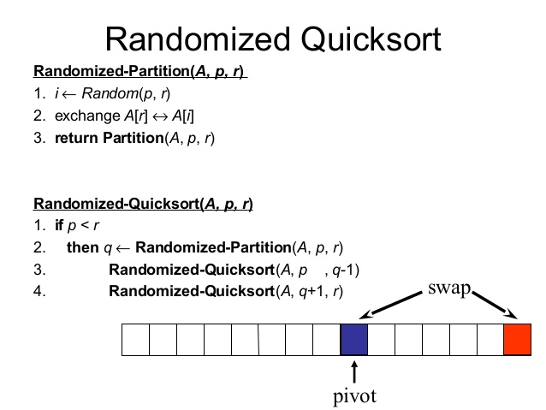
Randomized Quicksort Algorithm

Slide 4
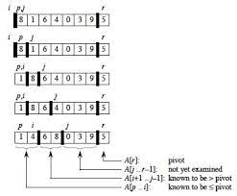
Working of Randomized Quicksort

Slide 5


Time Complexity of RQ..
Randomized quicksort has expected time complexity as $O(nlgn)$,but worst-case time complexity remains same. In worst case the randomized function can pick the index of corner element every time.

Slide 6

Procedure
We did Randomized Quicksort for different array size, which starts from 2 and increments in powers of 2 till our system gives Error due to Huge Size
We were able to record observation from array size $2$ to array size $2^{20}$
For each array size $n$, we sorted 50 different arrays of size $n$, taken from the datasets made in Question 1. Recorded the number of comparison and Time Taken per sort, then took their mean.
We then Plotted the following graphs for both datasets
$comparision ratio= \frac{avg_comp}{nlgn}$ vs $n$
$time ratio= \frac{avg_time_taken}{nlgn}$ vs $n$
We also plotted the usual Quick Sort Observations for comparisons too.

Slide 7
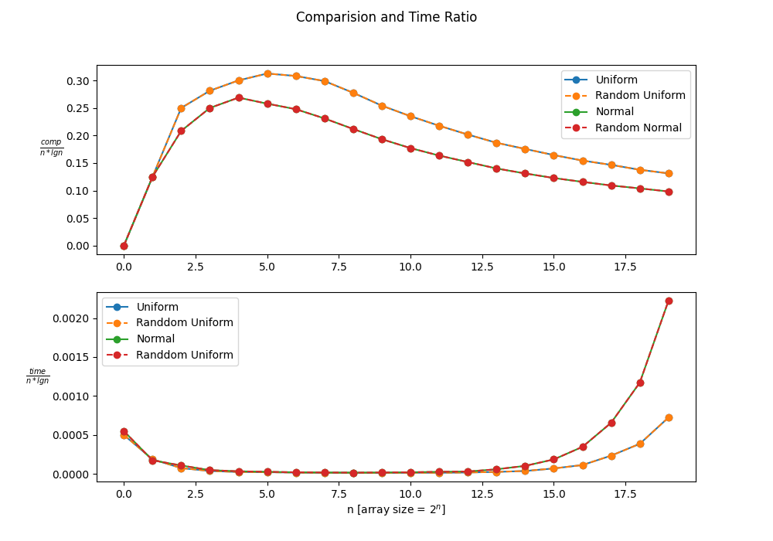

Observation
Following Inference can be made by the Observed Graph:
As we did 50 sorts per n, and took its mean, the time complexity comes out to be same as Non-Random Quick Sort, i.e., $O(nlgn)$
As array size keep increasing, we see similar observation, i.e., the comparison ratio and time ratio converges.
The Divergence of Time ratio for Big array size might be linked to low system RAM. which asks for more Secondary Memory Calls

Slide 8
Question 5
Now normalize both the datasets in the range from 0 to 1 and implement bucket sort (BS) algorithm and check for correctness

Slide 9

Procedure
As All Values in our dataset was between 0 and 100, we took each value one by one, divided each value by 100, and then saved it to a different files.
The no. of data in the dataset was kept same, i.e. ${10}^{6}$
We Then Plotted the histogram of the datasets to make sure the conversion was conversion was correct.

Slide 10
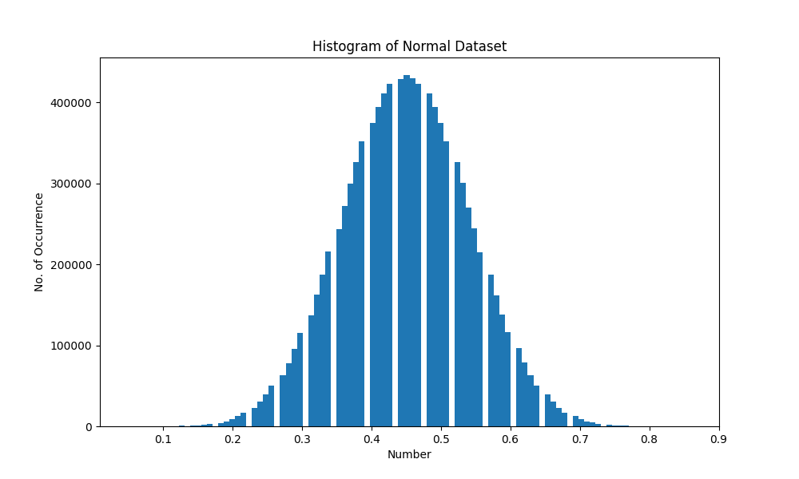
Histogram for Normal Dataset
As Expected, the histogram has the dumbbell curve and max value of the dataset goes to 1.
Hence, our conversion was successful

Slide 11
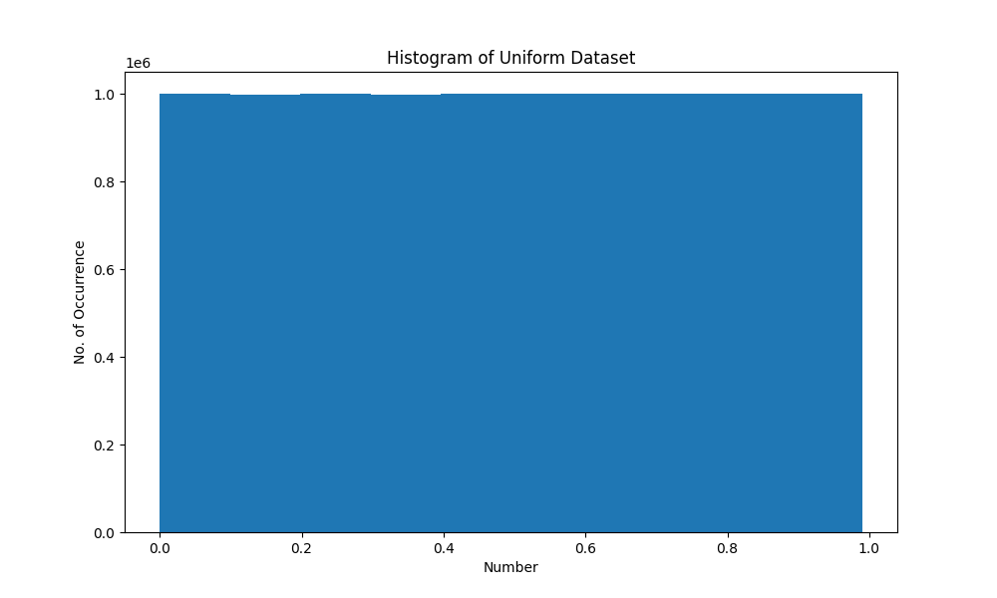
Histogram for Uniform Dataset
As Expected, the histogram has the same number of occurrences for every numbers range and max value of the dataset goes to 1.
Hence, our conversion was successful

Slide 12
Question 6
Experiment with Bucket sort to arrive at its average complexity for both Uniform and Normal datasets and infer.

Slide 13

What is Bucket Sort
Bucket sort, or bin sort, is a sorting algorithm that works by distributing the elements of an array into several buckets. Each bucket is then sorted individually, either using a different sorting algorithm, or by recursively applying the bucket sorting algorithm. It is a distribution sort, a generalization of pigeonhole sort, and is a cousin of radix sort in the most-to-least significant digit flavor. Bucket sort can be implemented with comparisons and therefore can also be considered a comparison sort algorithm. The computational complexity depends on the algorithm used to sort each bucket, the number of buckets to use, and whether the input is uniformly distributed.

Slide 14
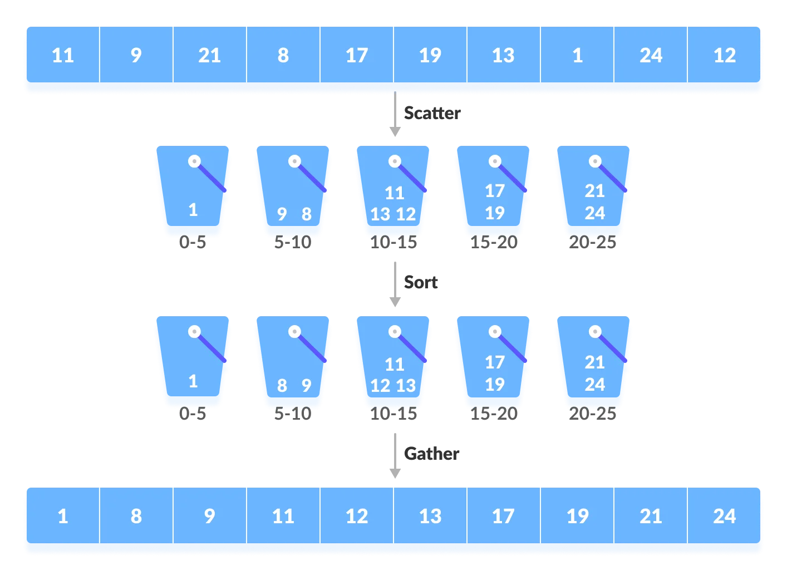
Bucket sort algorithm….

Slide 15
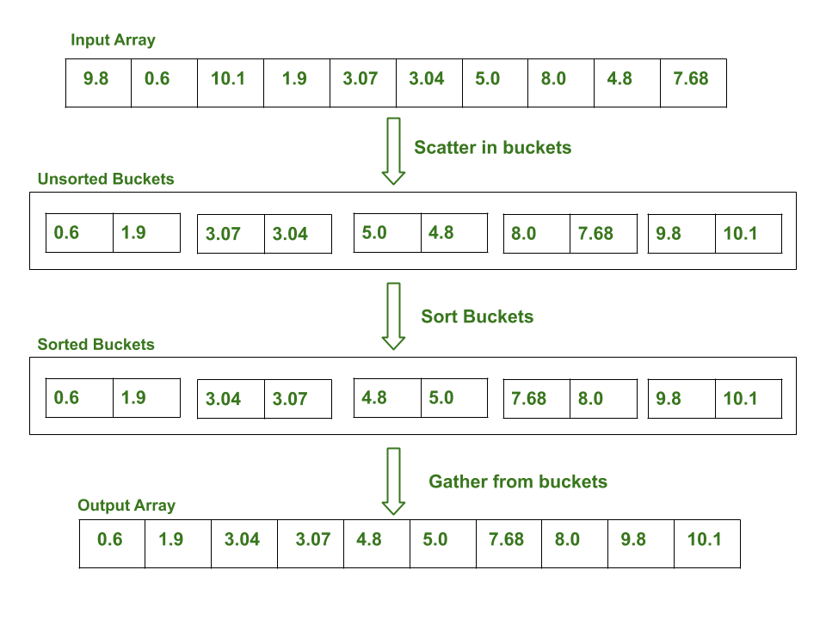
Bucket sort implementation on an array

Slide 16
The complexity of the Bucket Sort Technique
Time Complexity: $O(n+k)$ for best case and average case and $O(n^{2})$for the worst case.
Time Complexity: 𝑂(𝑛+𝑘) for best case and average case and 𝑂(𝑛^2)for the worst case.
Space Complexity: $O\left(nk\right)$ for worst case
Space Complexity: 𝑂(𝑛𝑘) for worst case

Slide 17

Procedure
We did Bucket Sort for different array size, which starts from 2 and increments in powers of 2 till our system gives Error due to Huge Size
We were able to record observation from array size $2$ to array size $2^{19}$
For each array size $n$, we sorted 100 different arrays of size $n$, taken from the datasets made in Question 1. Recorded the number of comparison and Time Taken per sort, then took their mean.
We then Plotted the following graphs for both datasets
$comparision ratio= \frac{avg_comp}{n}$ vs $n$
$time ratio= \frac{avg_time_taken}{n}$ vs $n$

Slide 18
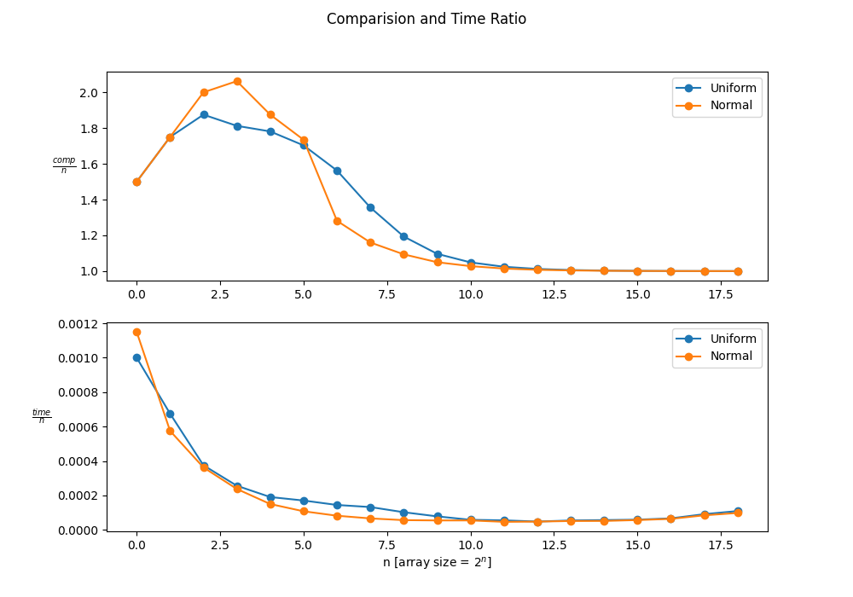
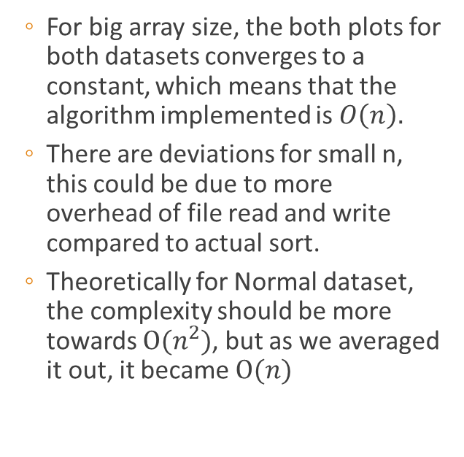
Observation
For big array size, the both plots for both datasets converges to a constant, which means that the algorithm implemented is 𝑂$\left(n\right).$
There are deviations for small n, this could be due to more overhead of file read and write compared to actual sort.
Theoretically for Normal dataset, the complexity should be more towards $O(n^{2})$, but as we averaged it out, it became $O(n)$

Slide 19
Question 7
Implement the worst case linear median selection algorithm by taking the median of medians (MoM) as the pivotal element and check for correctness.

Slide 20


What is Median Of Median (MoM)
The Median of Medians is an approximate (median) selection algorithm, frequently used to supply a good pivot for an exact selection algorithm, mainly the quicksort, that selects the $k^{th}$ largest element of an initially unsorted array.
Median of medians finds an approximate median in linear time only, which is limited but an additional overhead for quicksort.
When this approximate median is used as an improved pivot, the worst-case complexity of quicksort reduces significantly from $O\left(n^{2}\right)$ to $O\left(nlgn\right)$ , which is also the asymptotically optimal worst-case complexity of any sorting algorithm.

Slide 21
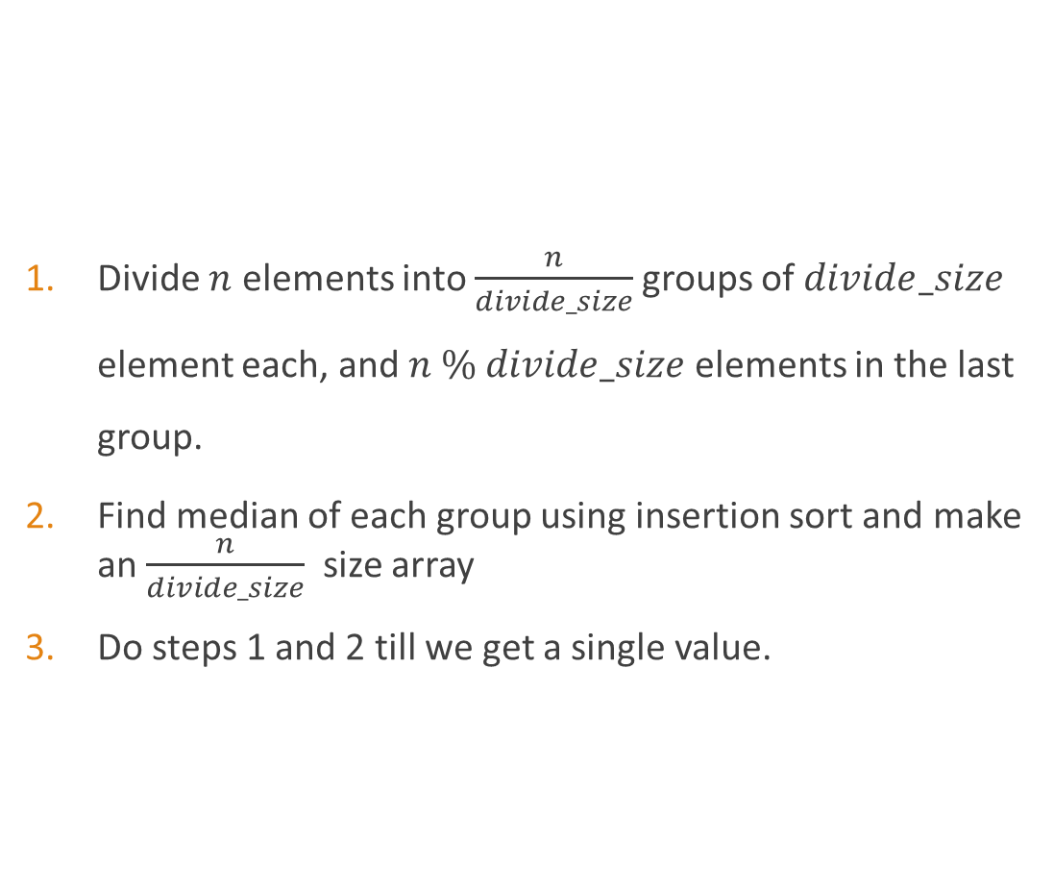
Median Of Median Algorithm
Divide $n$ elements into $\frac{n}{divide_size}$groups of $divide_size$ element each, and $n \% divide_size$ elements in the last group.
Find median of each group using insertion sort and make an $\frac{n}{divide_size}$ size array
Do steps 1 and 2 till we get a single value.

Slide 22
The complexity of the Median Of Median
Time Complexity: $O(n)$ for worst case
Time Complexity: 𝑂(𝑛) for worst case

Slide 23
Question 8
Take different sizes for each trivial partition (3/5/7 ...) and see how the time taken is changing.

Slide 24

Procedure
We did Median of Median for fixed array size ${10}^{5}$, but varied the divide size in $\{3,5,7,9,…,2003\}$
For each divide size, we computed MoM for 10 different arrays, generated randomly (Uniform) with number in range $(0,100)$. Recorded Time Taken per Pass, then took their mean.
We then Plotted the graph of time vs divide size

Slide 25
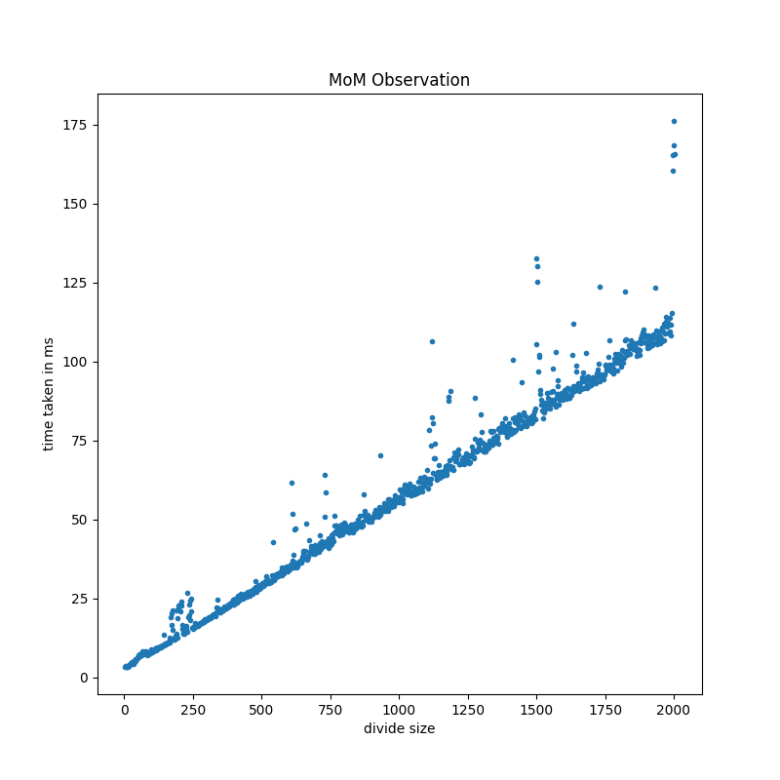
Observation
From the graph we can infer that time complexity is Linear with Divide Size

Slide 26
Question 9
Perform experiments by rearranging the elements of the datasets (both UD and ND) and comment on the partition or split obtained using the pivotal element chosen as MoM.

Slide 27

Procedure
We did Median of Median for divide size 5, but varied the size of array from 100 to ${10}^{5}$, with increments of 100
For each array size, we computed MoM for 10 different arrays, chosen randomly form the datasets generated at question 1. used Partition() with MoM as pivot element, and recorded the output position, then took their mean.
We then Plotted the graph of $\frac{partition}{arr_size}$ vs $arr_size$ for both datasets.

Slide 28
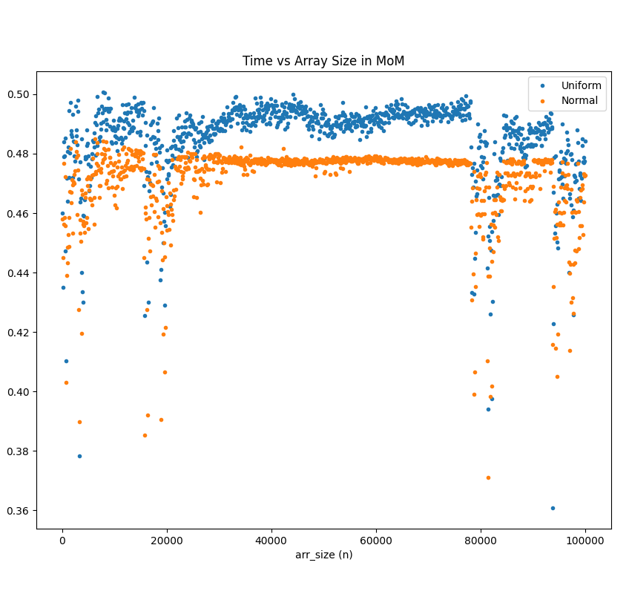
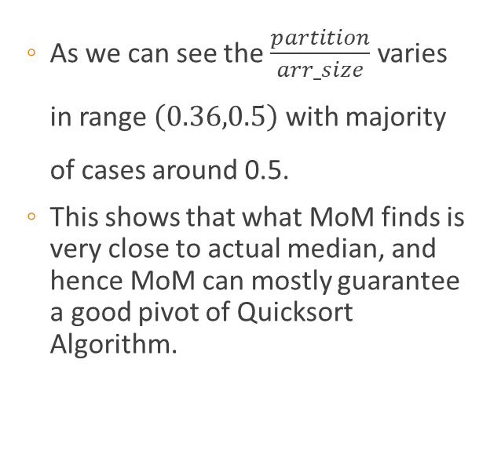
Observation
As we can see the $\frac{partition}{arr_size}$ varies in range $\left(0.36,0.5\right)$ with majority of cases around 0.5.
This shows that what MoM finds is very close to actual median, and hence MoM can mostly guarantee a good pivot of Quicksort Algorithm.

Slide 29
The End

